Slide 1
Predicting Diagnosis of Cervical Cancer Based on Risk Factors
Dany Trainor

Slide 2
Data and Goals
Data was collected from the UCI machine learning repository, originally collected via an anonymous survey conducted at Hospital Universitario de Caracas in Caracas, Venezuela
Data includes 32 risk factors and results of 4 diagnostic tests for cervical cancer for each survey respondent
Goal is to develop a machine learning model that can learn from this data and predict positive biopsy results for cervical cancer

Slide 3
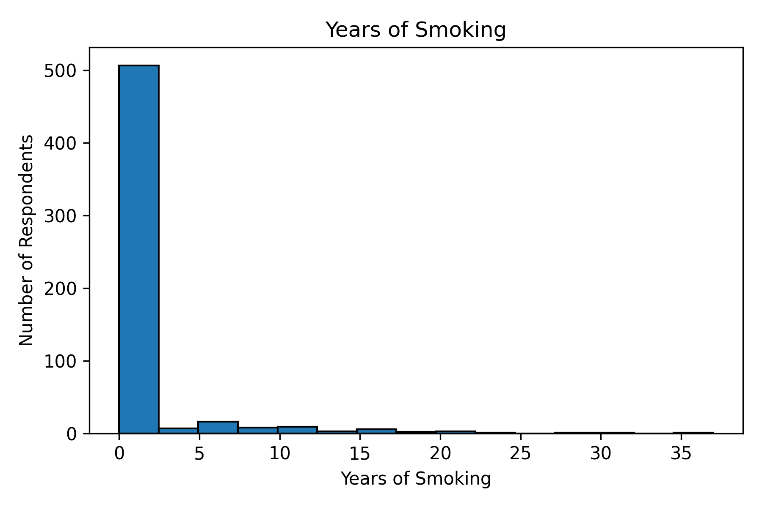

Slide 4
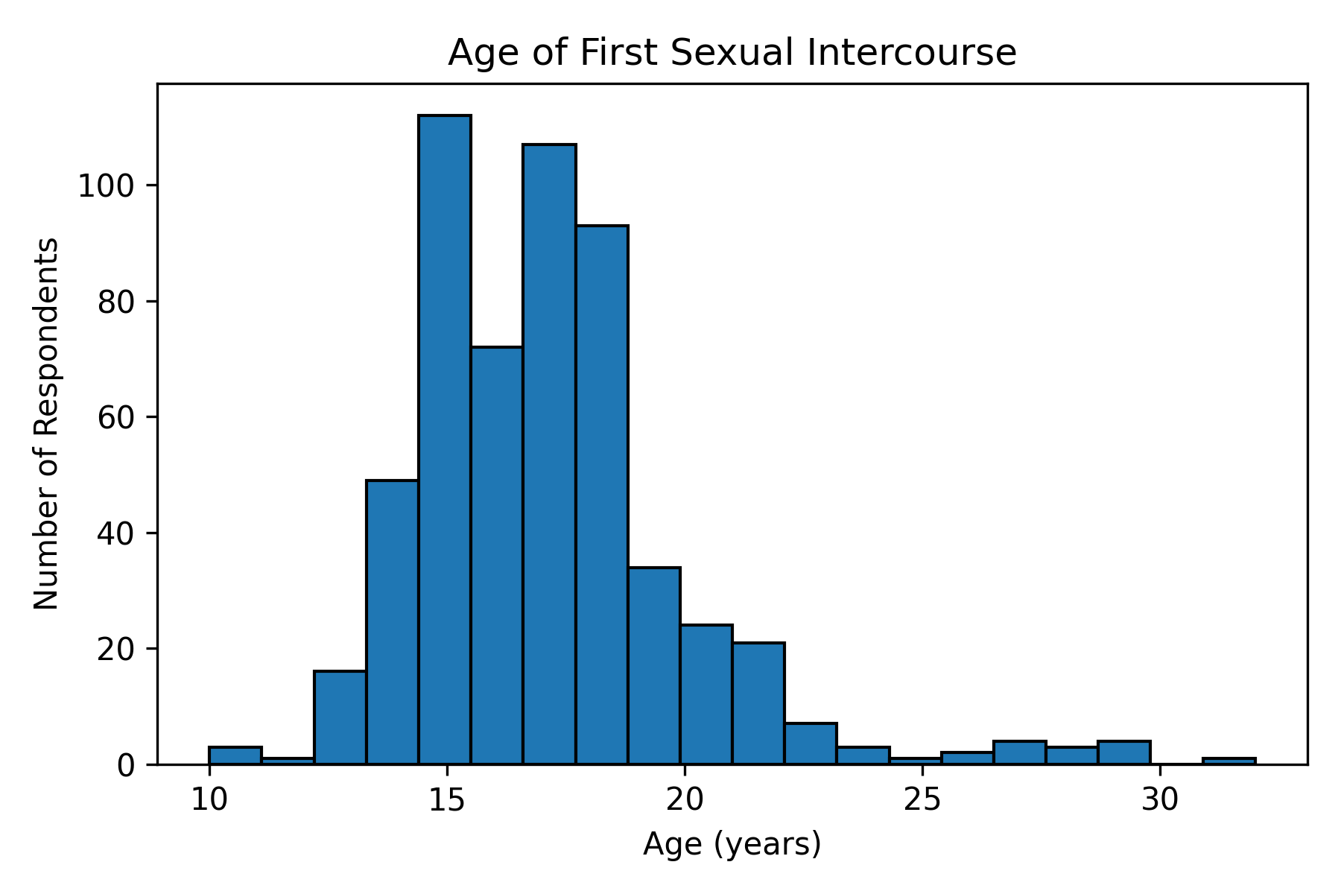

Slide 5
Model: Neural Network
Several models were built, but imbalanced data caused prediction issues
Neural networks make predictions, analyze their mistakes, and then learn from them the next time around
Neural network was able to achieve 94% accuracy, still has trouble predicting from imbalanced data. Only predicts negative cancer results

Slide 6
Recommendations
More data: Larger sample with varied demographics, ideally data from multiple international hospitals and multiple survey takers
Modify survey: more risk factors including a larger variety of health issues that can impact cervical cancer development and lifestyle information
Analyze differences in diagnostic techniques

